Slide 1

Neural Network based Block Codes
Enmao Diao, Yi Feng
July 15, 2019

Slide 2
Channel Coding
Information is transmitted through channels (eg. Wires, optical fibres and even air)
Channels are noisy and we do not receive what was transmitted

Slide 3
Channel Coding
message length k
codeword length n

Slide 4
Neural Network based Block Codes
We use vanilla Neural Network (ReLU for hidden layers, and HardTanh for binarization)
100 hidden nodes, number of hidden layer L
We do not use parametrized decoder as in end-to-end autoencoder framework [1]
Instead of using bitwise loss, we use cross entropy loss to classify the received codes. The probability is defined with the Euclidean distance between received codes and codebook (common soft decoding techniques used in classical channel decoding)
10 random experiments on AWGN. Train and Test with 200,000 samples. Batch size 5000, and SGD with cosine decay learning rate for 100 epochs

Slide 5
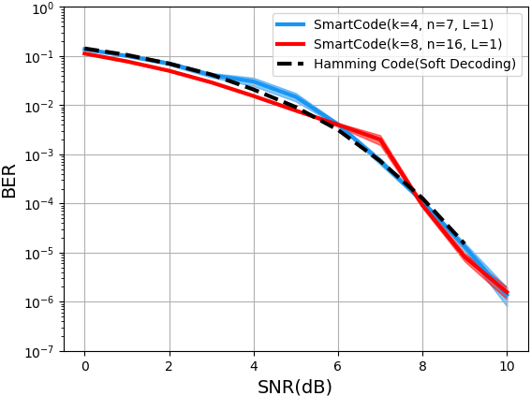
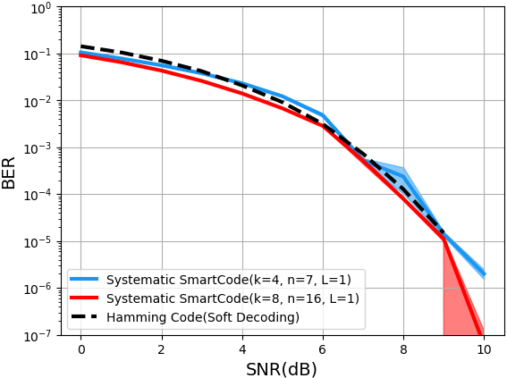
Result
L = 1

Slide 6
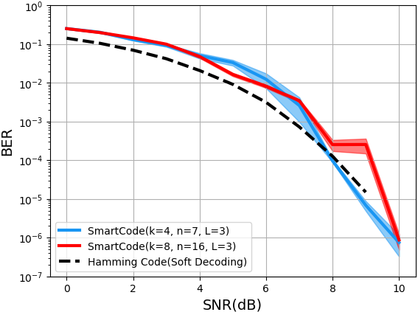
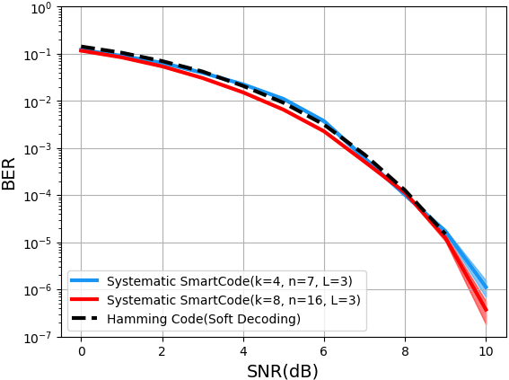
Result
L = 3

Slide 7
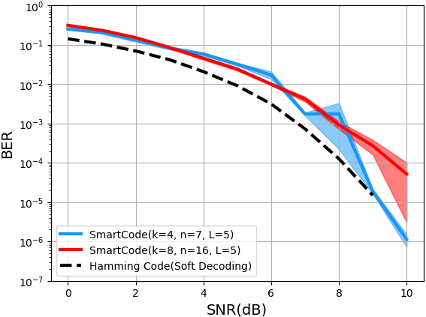
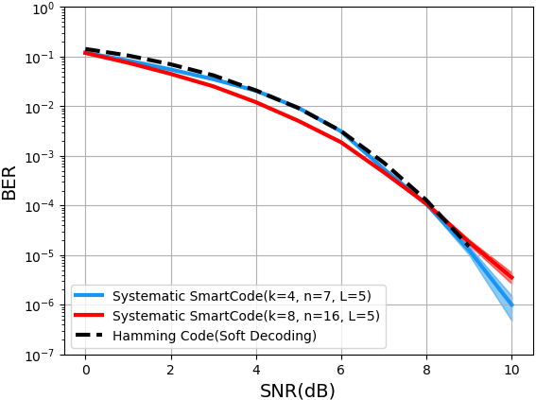
Result
L = 5

Slide 8
Discussion
Architecture
Feed-forward Neural Network hard to converge for over-parametrized models
residual connection and dropout for deeper layers
stochastic binarization
Convolutional Neural Network and recurrent networks for convolutional codes
Compare the performance with more classical designed block codes under different conditions (code rate and channel noise)

